Slide 1
A Contrast Enhancement Framework with JPEG Artifacts Suppression
Presenter: Nguyen Khac Thai
Author: Yu Li, Fangfang Guo, Robby T. Tan, and Michael S. Brown
National University of Singapore
Computer Vision – ECCV 2014 pp 174-188

Slide 2
Content
Contrast enhancement
The artifact
Proposed method
Structure-texture decomposition
Reducing artifacts in the texture layer
Layer recomposition
Result & Conclusion

Slide 3
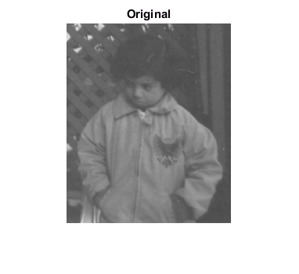
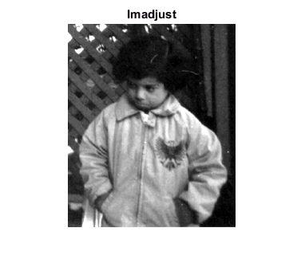
Contrast enhancement
Commonly used in computer vision
Histogram equalization
Tone-curve manipulation
Deal with degradation from physical phenomena
Haze, fog, underwater imaging
Contrast enhancement method
Apply a function to pixel intensity value
Ie = f(I)
Either manually determined function
Or se pre-defined curves function
example

Slide 4
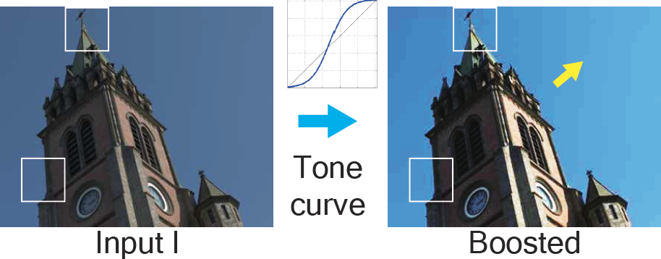
The artifact
If input image have visual artifacts
They may be boosted after contrast enhancement
Most common one are blocking and ringing artifacts
Highly compressed JPEG
Images from commodity devices
like surveillance cameras

Slide 5
The artifact
Deblocking state-of-the-art methods
Shape-adaptive DCT (SA-DCT)
Reconstruction based using Field of Experts (FoE)
Learning based Neural Network (NN)
For contrast enhancement, these methods could be used as
Pre-processing step
Post-processing step
Input
Deblocking
Contrast Enhancement
Output
Deblocking as pre-processing step
Input
Contrast Enhancement
Deblocking
Output
Deblocking as post-processing step

Slide 6
Proposed Method
The main idea
Decompose image to structure and texture layer
Process each layer differently

Slide 7
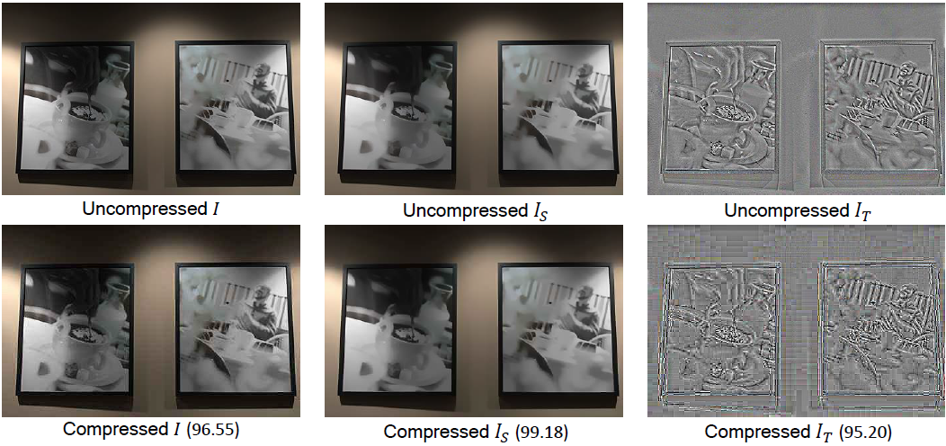
Structure-texture decomposition
I= I_{S} + I_{T}
I_{S} structure layer corresponding large objects in images
Related to larger gradient magnitudes
Can be calculated using any edge-aware smoothing operation
Bilateral filter, least square filter…
I_{T} texture layer corresponding to the fine details
Captures both fine image details and compression artifacts
Most compression artifacts are in texture layer

Slide 8
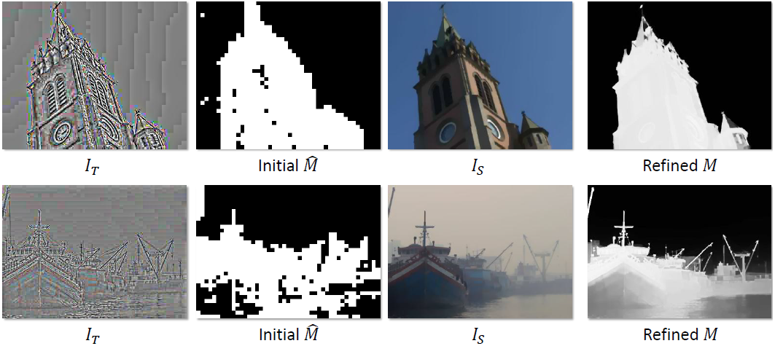
Reducing artifacts in the texture layer
Scene Detail Extraction
A mask is constructed to preserve image details
The initial results obtained by checking DCT coefficients
stronger high-frequency DCT coefficients means more details
A soft matting technique help refine the map

Slide 9
Reducing artifacts in the texture layer
Block Artifacts Reduction
For regions outside the mask
Content is removed altogether
Most likely compression artifact
For regions inside the mask
Is pixel density after deblocking
are the locations at the 8x8 block borders
First term keep output to be similar to the input
Second term smooths edges at 8x8 borders

Slide 10
Layer Recomposition
Most contrast functions f are not linear
Can not sum up the structure and texture layer after processed
Use Taylor series
The recomposition is estimated as
is pixel in structure layer
is deblocked pixel in texture layer

Slide 11
Result & Conclusion
tone-curve adjustment result with SSIM/PSNR

Slide 12
Result & Conclusion
Dehazing result

Slide 13
Result & Conclusion
underwater image enhancement result

Slide 14
Result & Conclusion
Quantitative comparison
Conclusion
The proposed method is better in terms of
removing artifacts (particularly with much less ringings)
preserving image details

